Slide 1
Explorer Compressor Inhibit & RECIRC Override Analysis
Connected Vehicle Analytic – GDIA
Mahtab J Fard
April 15, 2020
Ford Confidential

Slide 2
Background
Climate control team has been working on a Climate Quality Energy Room focused on reducing Warranty Spend. Compressor replacements is the #2 item for Climate. Within that category, there’s a significant number (35%) of returned compressors from warranty repairs that show no issue when they are analyzed (in particular on the pre-2020 Explorer). So they are trying to understand the underlying cause of the customer complaint of A/C slow to cool or does not work.

Slide 3
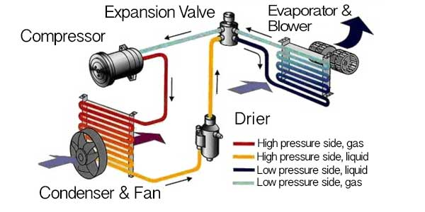
AC System & Sensors
Clutch On/Off
Engine RPM
Blower Speed
High Side Pressure
Evaporation Temperature
Fan Speed
Additional: Wiper Status, Ambient Air Temperature, Vehicle Acceleration, Vehicle Speed
*Reference: https://carhowto.com/how-your-cars-ac-system-works/

Slide 4
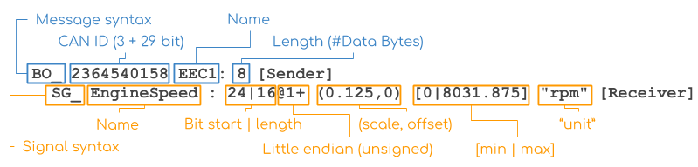
Big Data Drive (BDD) *:
Big Data Drive uses an Open XC plug-in device to record vehicle data.
The device is connected via the OBD II port and collects vehicle CAN data, which is then sent via Bluetooth to an onboard phone.
The phone then transmits the CAN data via WIFI (when the user connects while at home) or via cellular (select cases).
CAN messages are transmitted as encoded hexadecimal signals (ex. 0xcf390011030f0b0c) which then have to be decoded into human-readable values.
A DBC file encodes raw CAN vehicle data into a human-readable and standardized format. A vehicle may have multiple CAN buses (HS1/HS2/MS) and every CAN bus is represented by its own DBC file.
The image below shows the general structure of a DBC file - which is essentially a database format structured around messages and signals.
*Reference: https://github.ford.com/GDIA/ConnectedVehicleAnalytics/tree/master/BDD/decode

Slide 5
Objectives
We developed the following objectives with hopes to further analyze this climate system challenge.
Perform rudimentary analysis on Explorer.
Identify selection criteria for F-150s.
Determine CAN signals of interest.
Collect data for F-150s.
Conduct analysis.
Scale study to other vehicle types.

Slide 6
F-150 Selection Criteria
Ensure at least 30 days worth of recorded data transfers.
Preferable to select fewer vehicles with more frequent transfers, rather than more vehicles with less transfers and a shorter timestamp range.
Focus on 2018 & 2019 F-150.
Subset vehicles with transfer timestamps during summer months (May - August).
Select vehicles with variable displacement compressors.
64 2018 F-150s
784 F-150 VINs from BDD
100 2019 F-150s

Slide 7
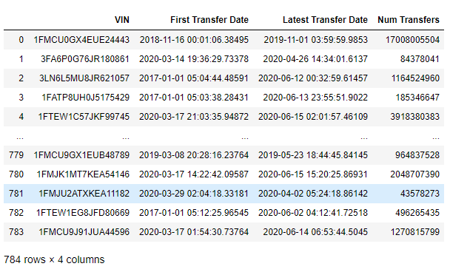
F-150 Selection
Extract all 784 F-150 VINs from BDD.

Slide 8
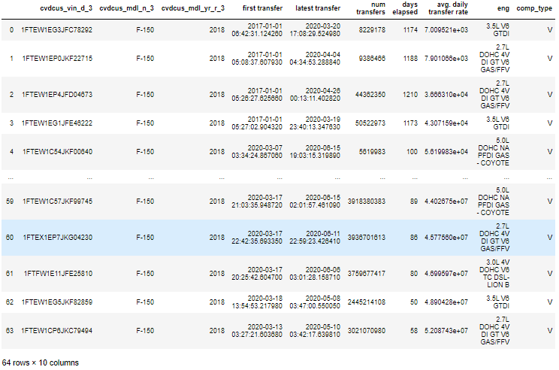
F-150 Selection
64 2018 F-150s subset based on selection criteria.

Slide 9
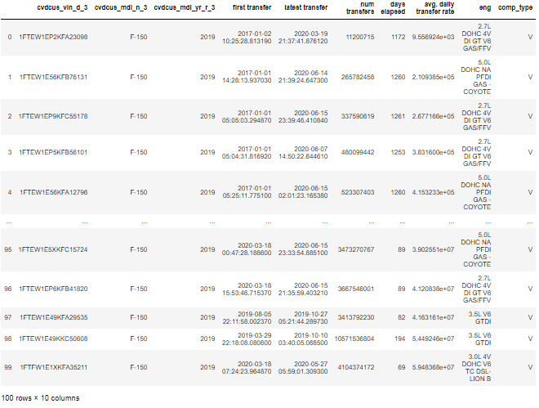
F-150 Selection
100 2019 F-150s subset based on selection criteria.

Slide 10
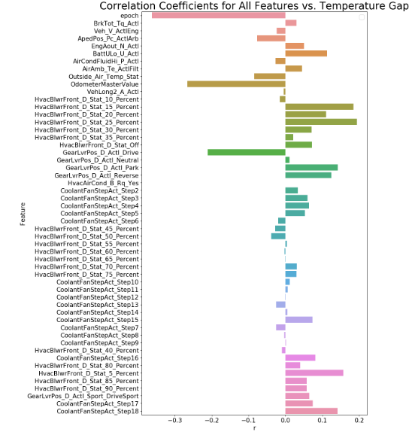
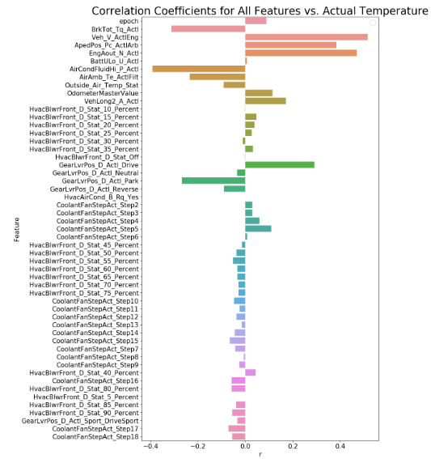
Understanding the Difference in Actual and Requested Temperature

Slide 11
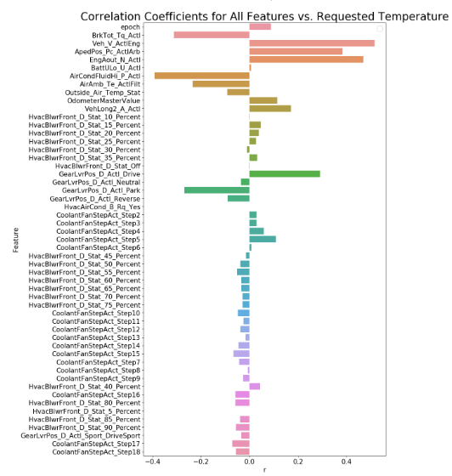
Understanding the Difference in Actual and Requested Temperature

Slide 12
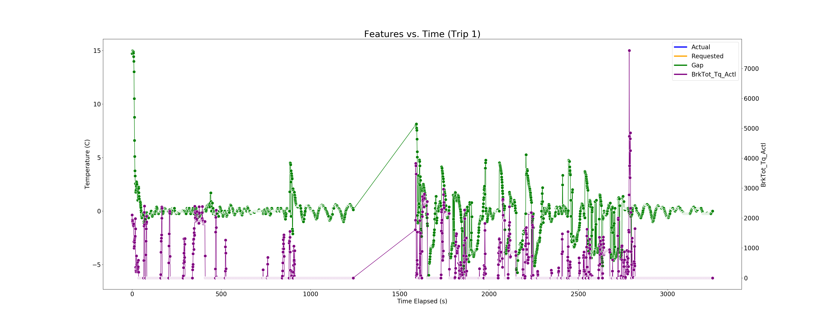
Understanding the Difference in Actual and Requested Temperature

Slide 13
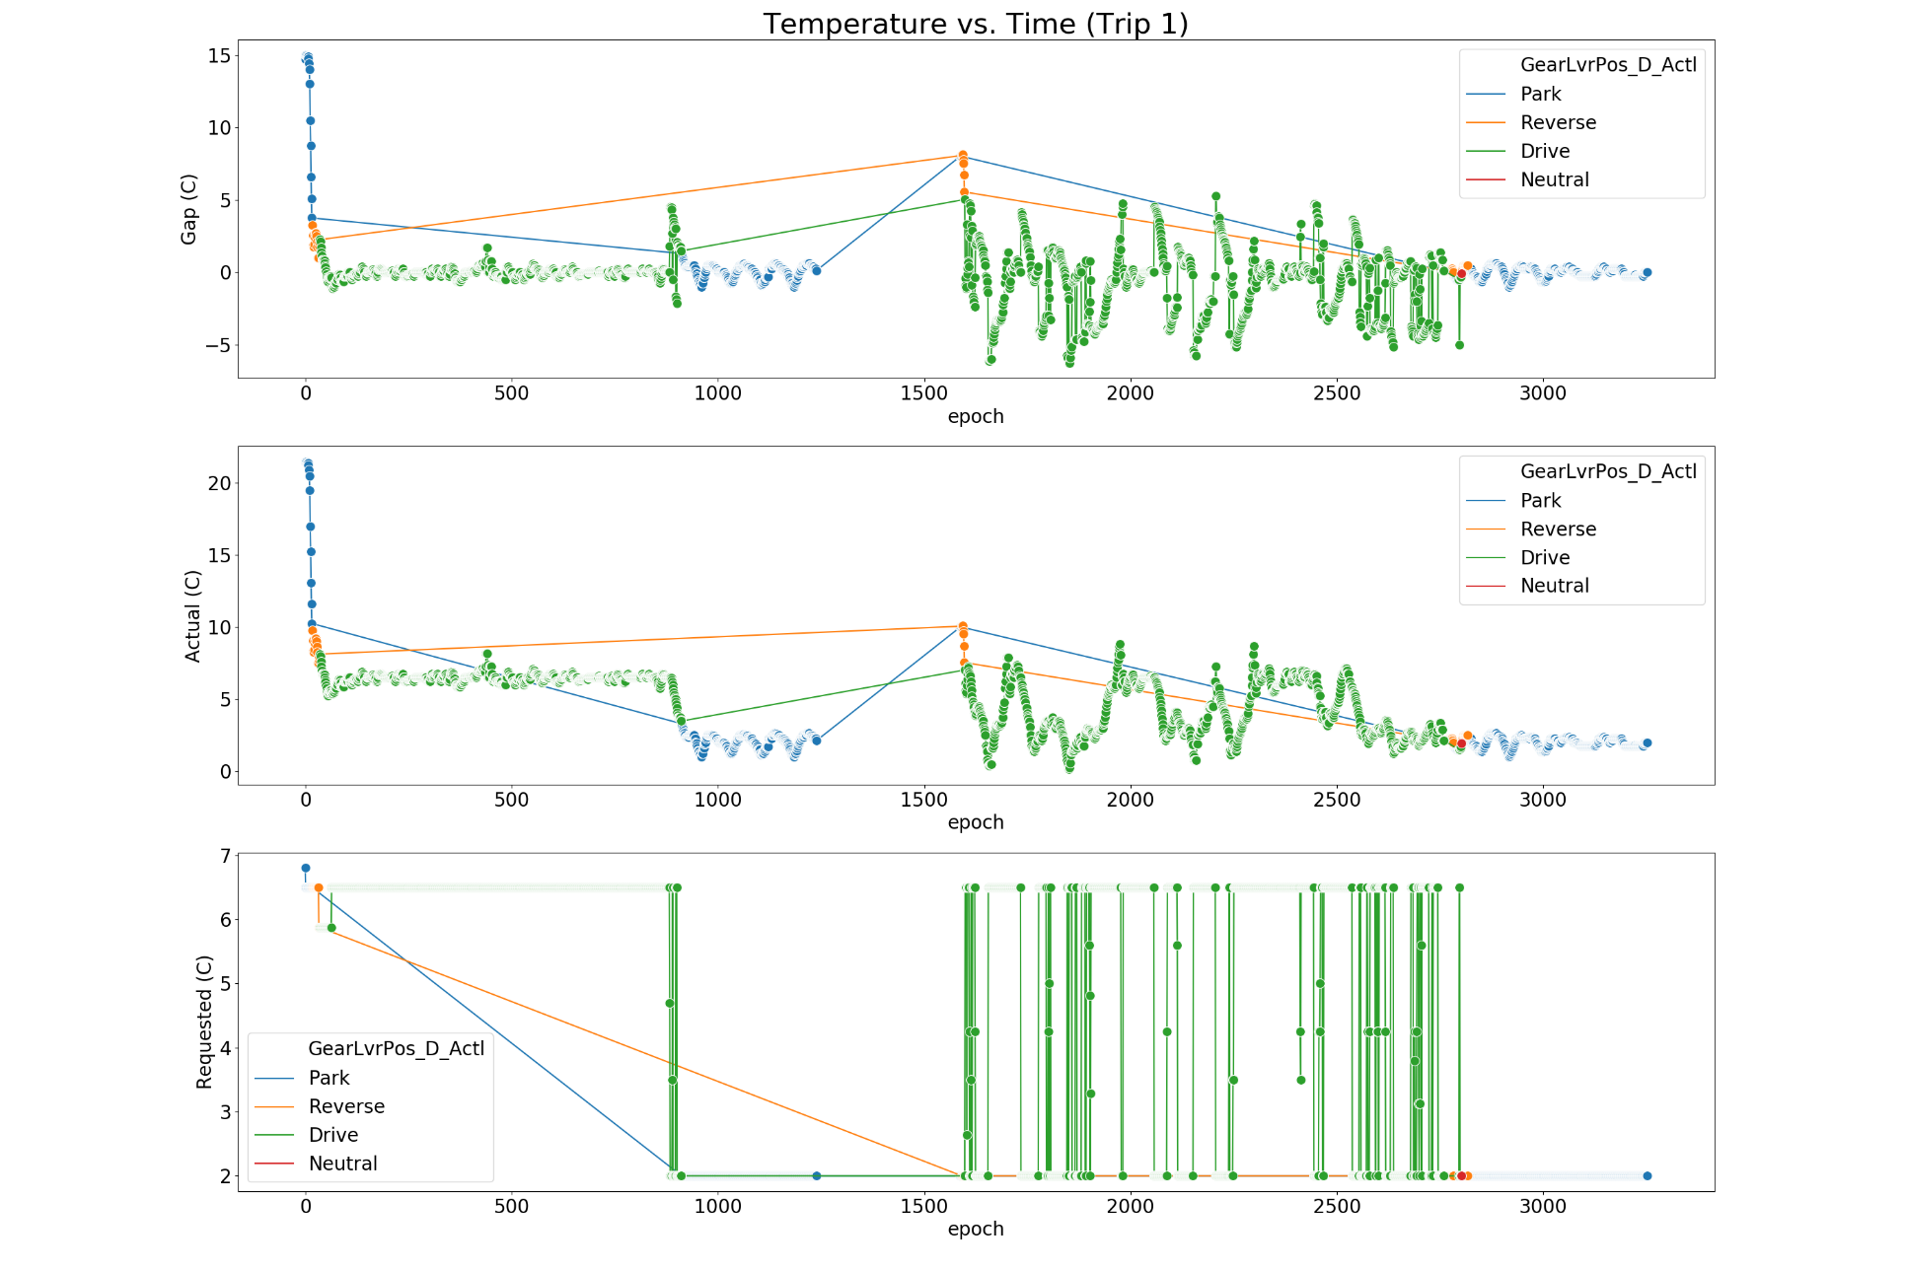
Understanding the Difference in Actual and Requested Temperature

Slide 14
Demo

Slide 15
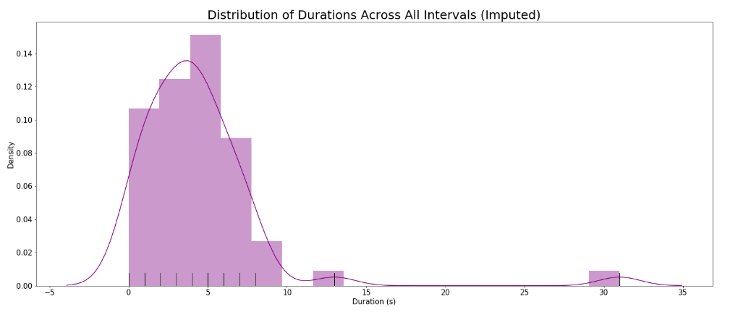
Analyzing Time Intervals With Negative Temperatures

Slide 16
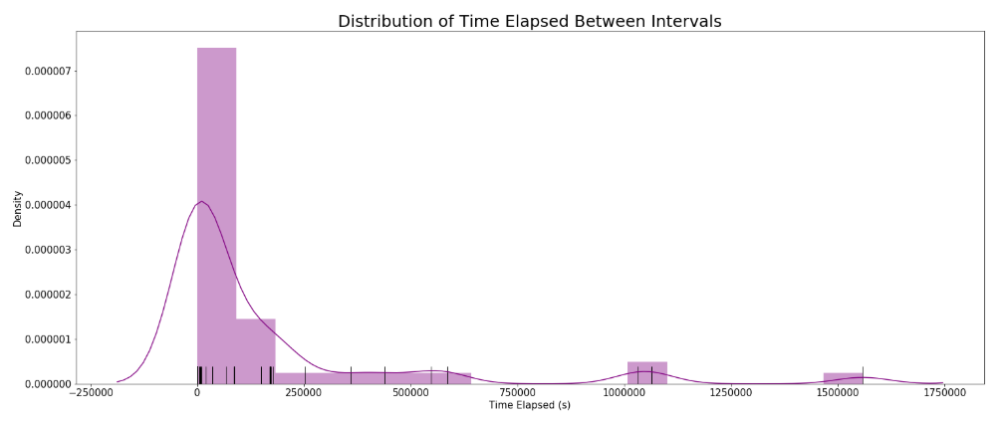
Analyzing Time Intervals With Negative Temperatures
Over the span of summer 2019 (May - July), the actual temperature is below 0°C every 161296 seconds (1.8 days) on average.

Slide 17
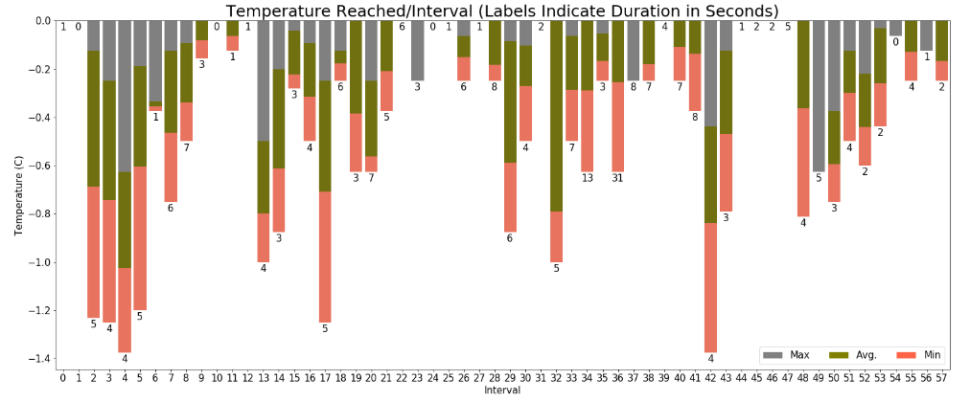
Analyzing Time Intervals With Negative Temperatures

Slide 18
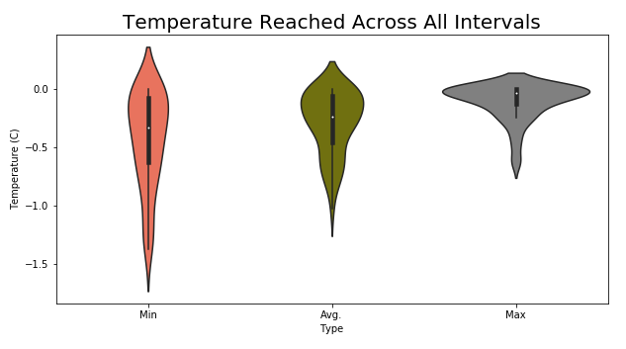
Analyzing Time Intervals With Negative Temperatures

Slide 19
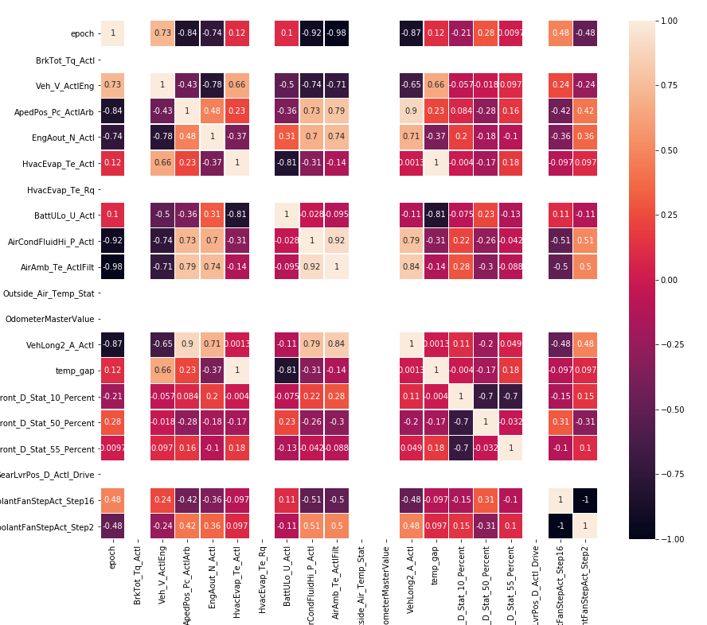
Analyzing Time Intervals With Negative Temperatures
Interval 57 looks particularly concerning, as it lasts the longest (31 seconds) and reaches a minimum temperature of -0.6.

Slide 20
What’s Next?
Perform rudimentary analysis on Explorer.
Identify selection criteria for F-150s.
Determine CAN signals of interest.
Collect data for F-150s.
Conduct analysis.
Scale study to other vehicle types.

